Slide 1
The Battle of Neighbourhoods
Author: Dheeraj Shaik

Slide 2
Contents
Introduction
Data Section
Methodology
Results
Discussions
Conclusion

Slide 3
Introduction
Purpose is to provide better neighbourhood
Drives people in choosing efficient neighbourhood
Provides details on various amenities in neighbourhood

Slide 4
Data Requirements
Scarborough Data :https://en.wikipedia.org/wiki/List_of_postal_codes_of_Canada:_M
Foursquare API
Libraries: Pandas, Scikit-Learn, XML, Folium, Matplotlib, JSON Geocoder: To access location data BeautifulSoup : To scrape the data from the web Requests: To handle http requests

Slide 5


Map of Scarborough

Slide 6
Methodology
A unsupervised learning algorithm is needed
K-Means Clustering found to be effective To explore neighbourhoods, explore them, segment them
Group them into clusters
Evaluate the similarity in finding the better neighbourhood

Slide 7
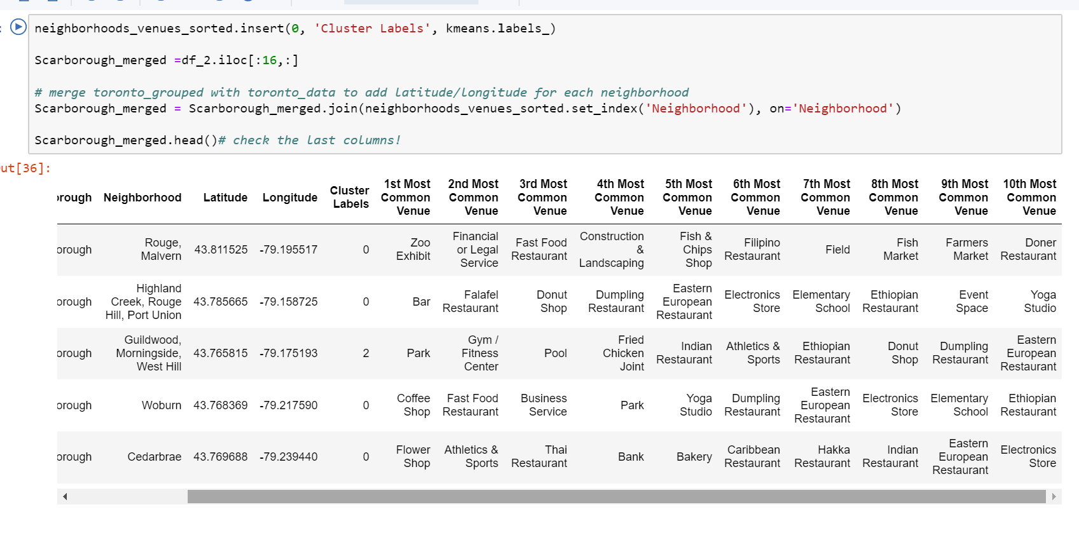

Slide 8
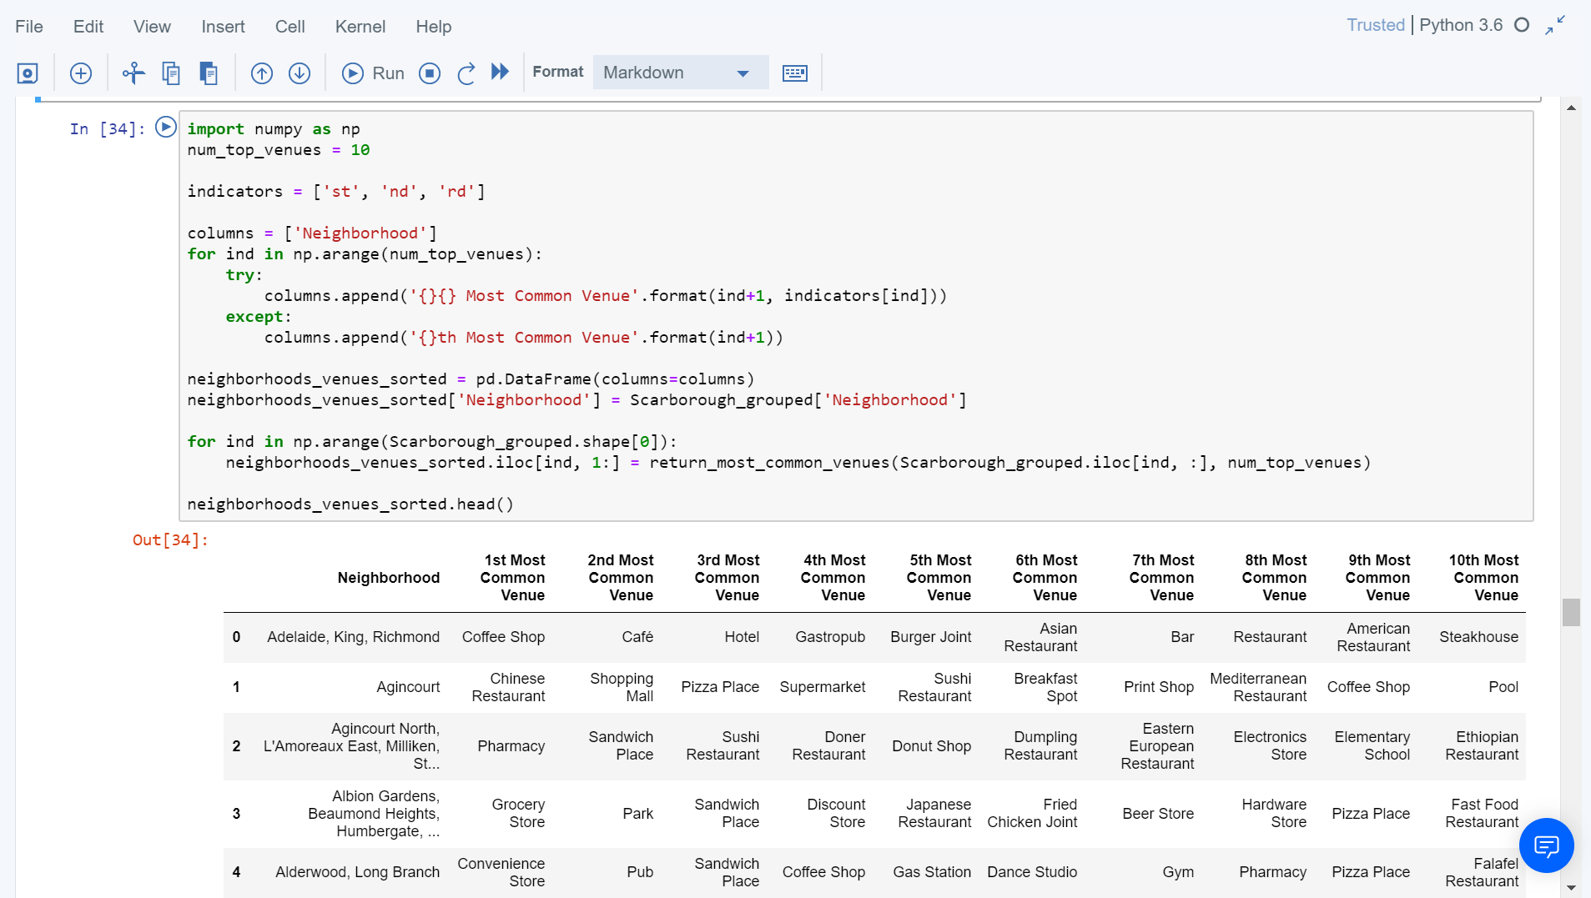

Slide 9
Workflow
Use Foursquare API credentials to find the venues in neighbourhood
Due to API limitations the venues in neighbourhood is set to 100
Radius parameter is set to 100

Slide 10

Results
Map of clusters in Scarborough

Slide 11
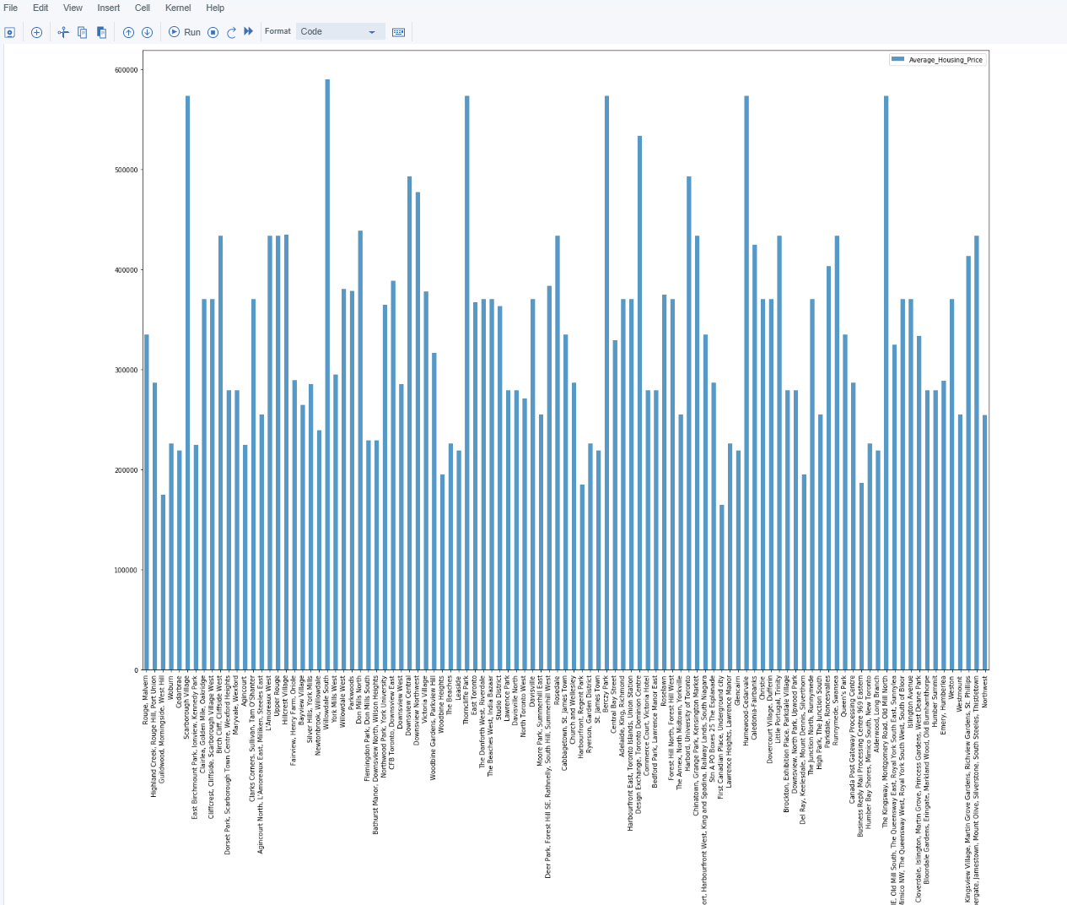
Average House Pricing by Clusters in Scarborough

Slide 12
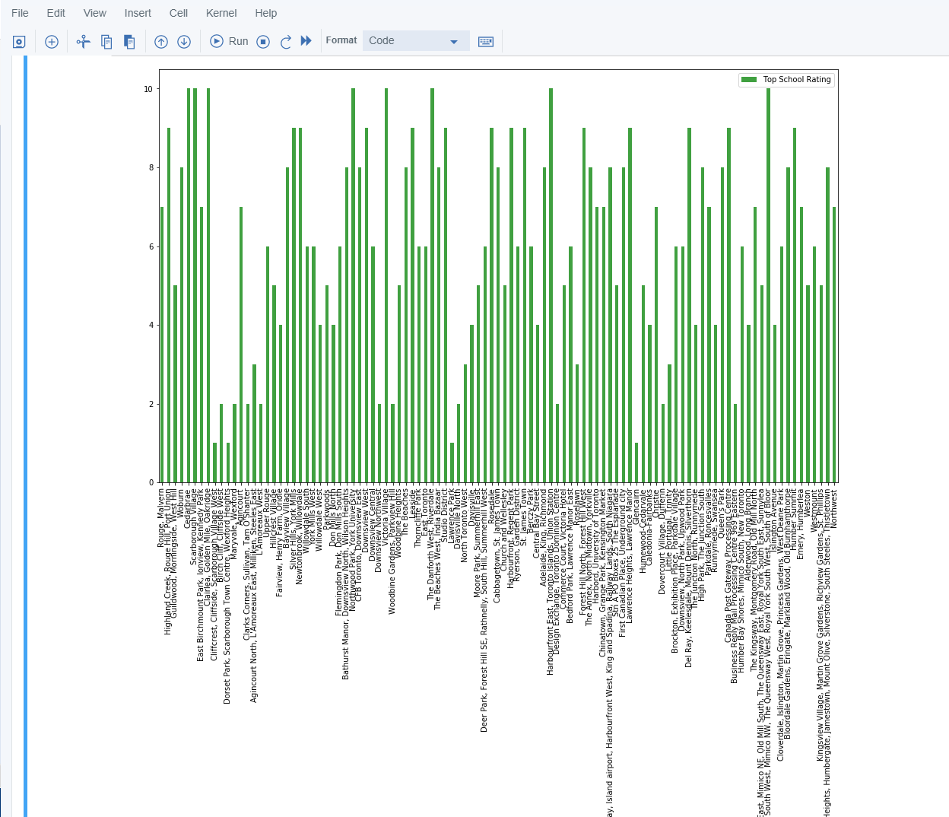
Top School Ratings by Clusters in Scarborough

Slide 13
Discussions
Problems tried to solve: Sorted list of house in terms of housing prices Sorted list of schools by ratings, locations, fee and reviews.
Thrives to provide social presence of like-minded people
Provides details about connectivity to the airport, city-center etc

Slide 14
Conclusion
Provides insightful information to people in finding a better neighbourhood
Tried separating 10 neighbourhoods from 103 different latitude and longitude values in dataset
Folium helps in consolidating information with data driven analysis and decision making with confidence

